Slide 1

Estimating Firebrand Properties from Multiple Video Cameras
By Team Falcons
AI-2 Final Project
Univ.AI
Chandra Prakash
Mohan Kumar
Rashmi Anchan
Rashmi Deshpande
1

Slide 2
Problem Statement
The questions we tried to answer are:
What is the energy content of the firebrand?
What is the size of the firebrand?
What is the general shape of the firebrand?
2
Notes:
In this project, we use image data collected from a system of 4 video cameras to characterize the firebrands and make a report of the accuracy of prediction, the assumptions and limitations in performing and completing the task.
What is the propensity for ignition?
Volume of the firebrand.
Length, Width, Height of the firebrand.
Orientation (3 D rotation angle) of the firebrand.
C. Is the firebrand a cylinder or a sphere or a disk?
3

Slide 3
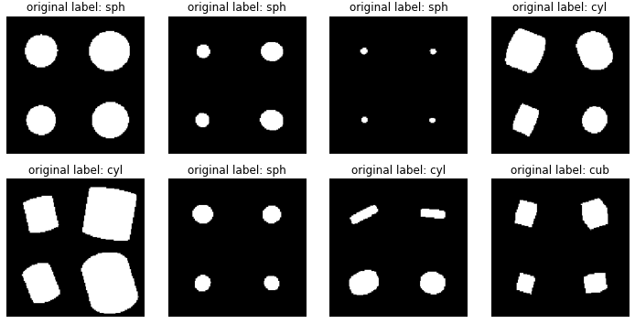
Data
3

Slide 4
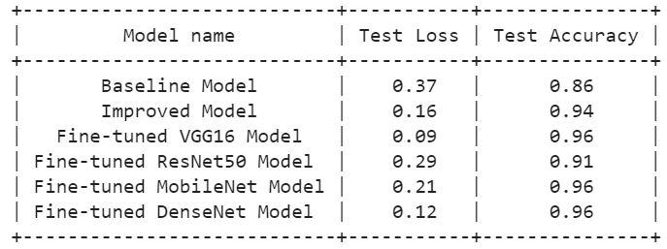
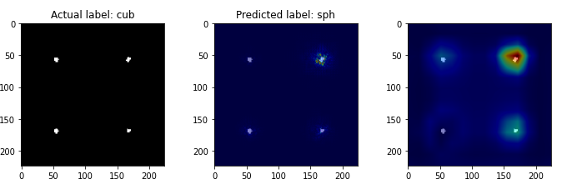
Classification
Mis-Classified Images - Grad-CAM
4

Slide 5
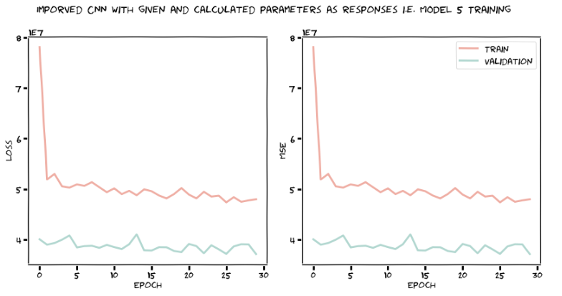
Regression
5

Slide 6
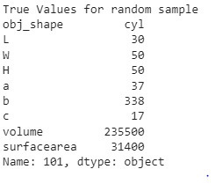
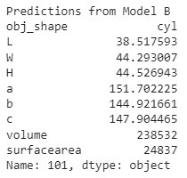
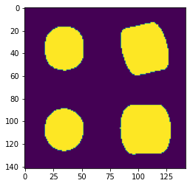
Results
6

Slide 7
Conclusion
Future Scope
We were able to predict properties of fire-brands using CNN models for both classification and regression tasks.
We were able to improve the predictions by adding more layers and using early stopping
Find Regression using Autoencoders
We can split the images to 4
images and see if it improves
the accuracy
7
Notes:
This proj we are predicting measurements of properties object

